Slide 1
Your Upcoming Commodities Order-Make the Most of it
KYLE JORDAN
USDA FOODS FOR SCHOOLS PROGRAM DIRECTOR AMY HAYDEN
SUPERVISOR, LEON COUNTY SCHOOLS

Slide 2
Agenda
The current state of USDA Foods
Supply chain update
Order Changes & Modifications
What’s Next
Options
Help Yourself
Best Practices
Reminders

Slide 3
What’s Happening in USDA Foods
Unfortunately, the current challenges are expected to continue
Prices are too high for USDA
Lack of transportation
Poor harvests and growing conditions
Staffing/labor shortages
Commercial demand
Need to plan accordingly and have backup products ready

Slide 4
Supply Chain Update
Good
Green Beans are in surplus and additional offerings may become available
Trucking has become less of an issue
USDA is working hard to get all orders purchased which means
That delivery periods may be required to be moved for the order to be purchased
The product received, may be a little different than what was requested
Diced, may be sliced
No-Sodium, may be Low-Sodium

Slide 5
Supply Chain Update
Bad
All grains and grain-based items are in short supply and prices are increasing
Peas have a severe shortage and USDA is trying to find substitutions
Packaging materials for direct delivery are in short supply
Trucking is still causing delays but are diminishing

Slide 6
Order Changes & Modifications
It all depends on:
Order Status
Delivery Period
If other recipient agencies have allocations for the same orders

Slide 7
School Year 2022-2023 Entitlement
Current entitlement in the POINT System is an estimate
SY 22-23 Entitlement will not have a waiver as the last two school years did
SY 22-23 Entitlement will be updated with the actual amount of lunch meals claimed in October-November 2022

Slide 8
What’s Next
December 2022 Catalog
There will be direct delivery and processing catalogs
46 different items for direct delivery
31 different items for processing
These catalogs will be open from 11/21-12/8/22
Webinar will be scheduled prior to the catalogs opening

Slide 9
Hurricane Ian
Only USDA Foods served for congregate feeding are eligible
All other food claims are submitted to FEMA
If you only used direct delivery USDA Foods or DoD Fresh, the 292-A is only required
If you only used processed USDA Foods, we still need the 292-A in addition to the 292-B
Supporting Documentation is required
Forms and Documentation due dates will be announced soon

Slide 10
Options
After the December Catalog, the USDA Foods options are limited to:
Transfers for direct delivery inventory
Transfers for bulk for processing inventory
Allocating remaining entitlement to the USDA DoD Fresh Program
Potential USDA Foods bonus offerings

Slide 11
Help Yourself
Forecast
Select the USDA Foods Carefully
Is the USDA Foods used regularly and on your cycle menus?
Have you tested it with your students?
Is the USDA Food compatible with your storage capabilities?
Will your staff have time to prepare it?
Is it something that can be used in multiple meal services?

Slide 12
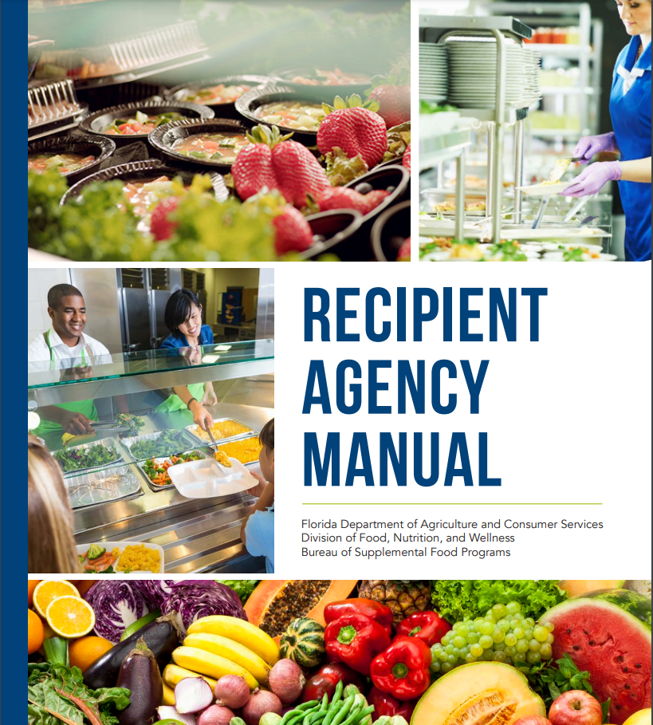
Recipient Agency Manual

Slide 13
Best Practices
Monitor your orders at least bi-weekly, if not weekly in the POINT System
Request modifications of your approved orders as needed
Request cancellations of your approved orders
Ensure that all orders are properly received and receipted
Complete monthly reconciliation of your USDA Foods instead of waiting until the end of the school year

Slide 14
Reminders
All products are not guaranteed and are subject to change due to:
Impacted Crops
Illness in Livestock
Food Safety Recalls
Excessive Demand

Slide 15
USDA Foods for Schools Contact Information
Kyle Jordan – NSLP-USDA Foods Program Director
(850) 617-7175 Kyle.Jordan@fdacs.gov
Erika Trawick – Processing Transfers
(850) 617-7464 Erika.Trawick@fdacs.gov
Kirkland Spraggins – Processing-MPR, Agreements, SEPDS
(850) 617-7159 Kirkland.Spraggins@fdacs.gov
Victoria Hatfield – State Warehouse Issues/Transfers
(850) 617-7166 Victoria.Hatfield@fdacs.gov
Ida Christie – DOD Fresh, Ordering, Complaints
(850) 617-7177 Ida.Christie@fdacs.gov

Slide 16
BEFORE YOU FORECAST…
Develop your menu
Based on the items available on your bid
Calculate the number of times each menu day is planned throughout the year

Slide 17
NOVEMBER
SUNDAY | MONDAY | TUESDAY | WEDNESDAY | THURSDAY | FRIDAY | SATURDAY
WK 1 |  | 1 | 2 | 3 | 4 | 5
6 WK 2 | 7 | 8 | 9 | 10 | 11 HOLIDAY | 12
13 WK 1 | 14 | 15 | 16 | 17 | 18 | 19
20 | 21 CLOSED | 22 CLOSED | 23 CLOSED | 24 CLOSED | 25 CLOSED | 26
27 WK 2 | 28 | 29 | 30
Notes:
Print out a calendar for August –May.
Designate the weeks based on menu cycle
Put holidays, TPD, etc. on it
Count how many times each menu day is on

Slide 18
Week 1:
Monday-14
Tuesday-17
Wednesday-19
Thursday-19
Friday-18
Week 2:
Monday-16
Tuesday-18
Wednesday-18
Thursday-18
Friday-17
Notes:
This is our breakdown
Since Monday Wk1 only has 14 days, you could put your most expensive meal there or least popular

Slide 19
BEFORE YOU FORECAST…
Develop your menu
Based on the items available on your bid
Calculate the number of times each menu day is planned throughout the year
Forecast the % of usage for each day in the menu cycle

Slide 20
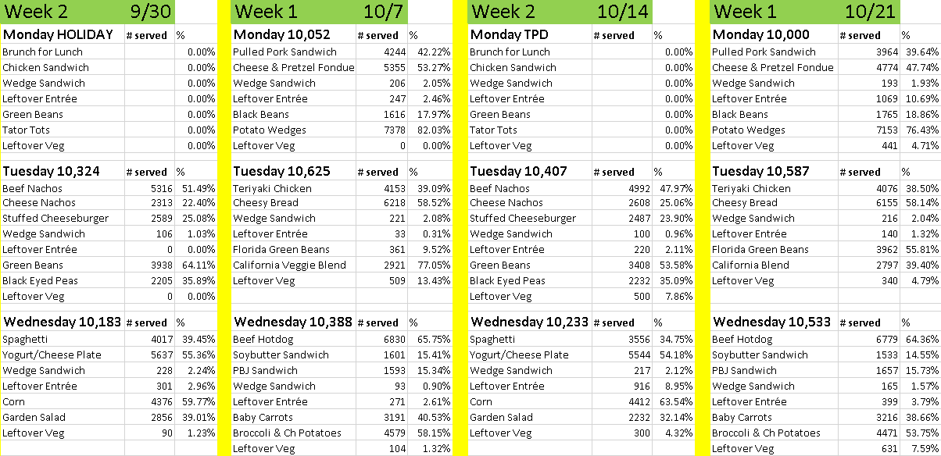
OCTOBER
Notes:
For each day in the menu cycle, figure out how many students will take entrée A compared to entrée B-same with veggies
I use October since in September students are still figuring out what they like and November and December aren’t full months
I use an average for the month
As you can see both Mondays Wk 2 has no data so I will have to use data from another month for that

Slide 21
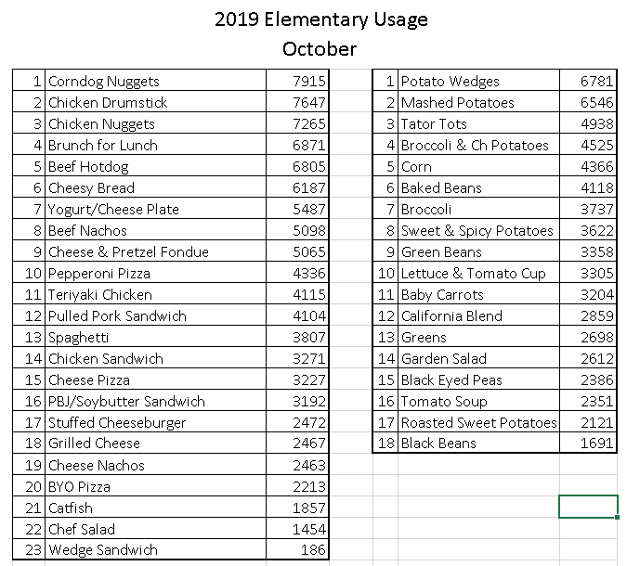
Notes:
This doesn’t really help with forecasting, but having the most popular and least popular is good info to have

Slide 22
EXAMPLE
Cheesy Breadsticks
Menued Tuesday of Week 1
Average for each time it is menued-6,187 servings
How many times it is on for the school year-17
6,187 X 17=105,179 servings for the school year

Slide 23
BEFORE YOU FORECAST…
Develop your menu
Based on the items available on your bid
Calculate the number of times each menu day is planned throughout the year
Forecast the usage % for each day in the menu cycle
Calculate how much of each end product is needed
Manufacturer calculators help
Notes:
Calculators usually come by email from the manufacturer or broker
If I don’t get them I will ask or sometimes just Google since it is faster

Slide 24
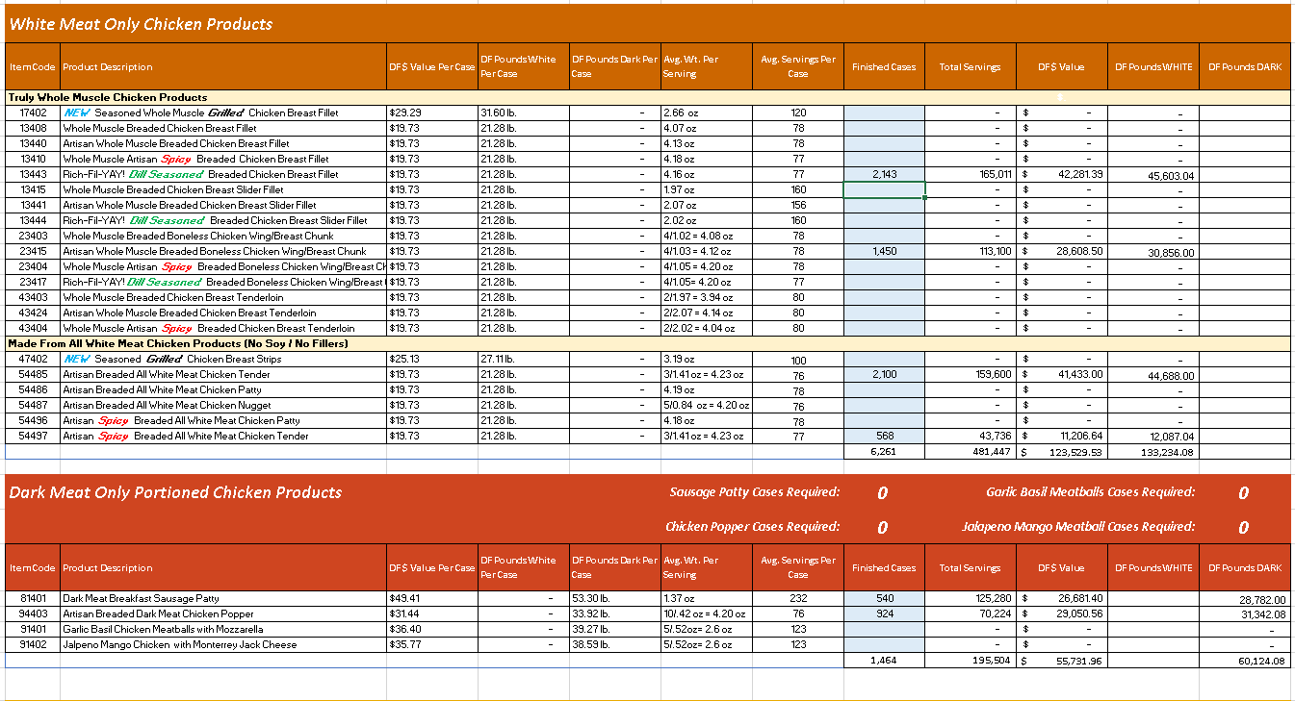
Notes:
This is for chicken
This manufacturer’s calculator makes sure the white and dark meat are equal
Some calculators want you to enter finished cases per year, while others ask for total servings or even by month

Slide 25
BEFORE YOU FORECAST…
Develop your menu
Based on the items available on your bid
Calculate the number of times each menu day is planned throughout the year
Forecast the usage % for each day in the menu cycle
Calculate how much of each end product is needed
Manufacturer calculators help
Put it all together to see where your entitlement is at
Notes:
You want to make sure that you have enough entitlement to cover the commodities you need

Slide 26
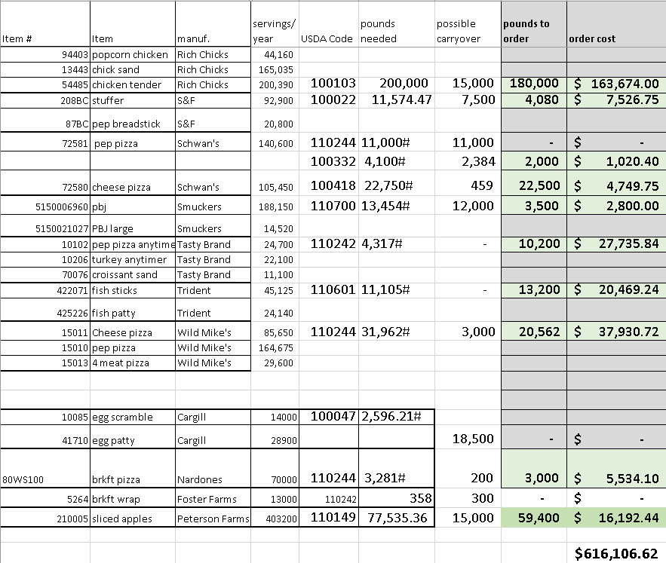
Rich Chicks Calculator
Tasty Brands Calculator
Notes:
Make sure to include any projected carryover you might have

Slide 27
BEFORE YOU FORECAST…
Develop your menu
Based on the items available on your bid
Calculate the number of times each menu day is planned throughout the year
Forecast the usage % for each day in the menu cycle
Calculate how much of each end product is needed
Manufacturer calculators help
Put it all together to see where your entitlement is at
When ordering, take into consideration how many pounds or cases are per truckload

Slide 28
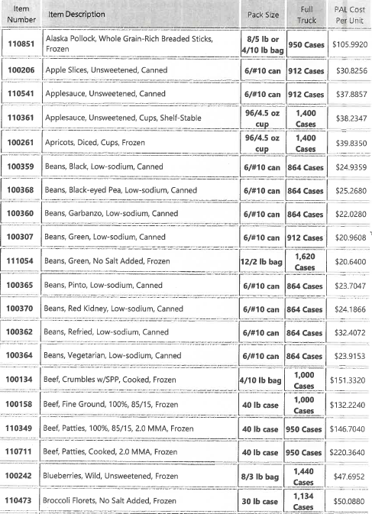
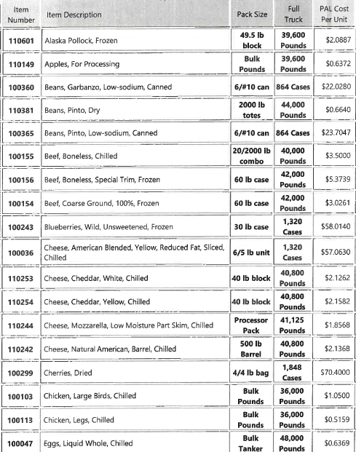
DIRECT
PROCESSED
Notes:
This comes from the P.O.I.N.T. system

Slide 29
PROCESSED CHICKEN EXAMPLE
From commodity calculator:
From my total spreadsheet:
From catalog:
Notes:
I rounded up to make an even number which is easier to work with
180,000 #’s is 5 truckloads

Slide 30
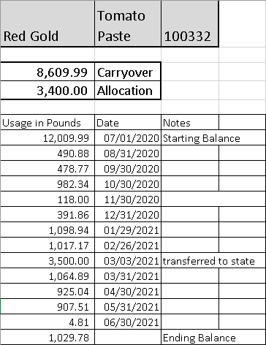
TRACKING THROUGHOUT THE YEAR
Notes:
I like to track on my own spreadsheet-reports on K12, PL, and independent vendors are all different
I can also make notes that might not show up on the other reports
By tracking throughout the year, you are prepared when a catalog opens

Slide 31
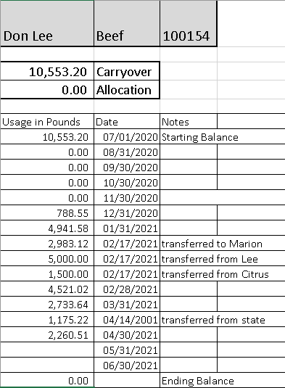
TRACKING THROUGHOUT THE YEAR

Slide 32
TRACKING THROUGHOUT THE YEAR
Notes:
I also track USDA foods that are in our warehouse
This helps with items that might not be menued, like assorted fruit

