Slide 1
Cut the Waste: Save the Environment

Slide 2
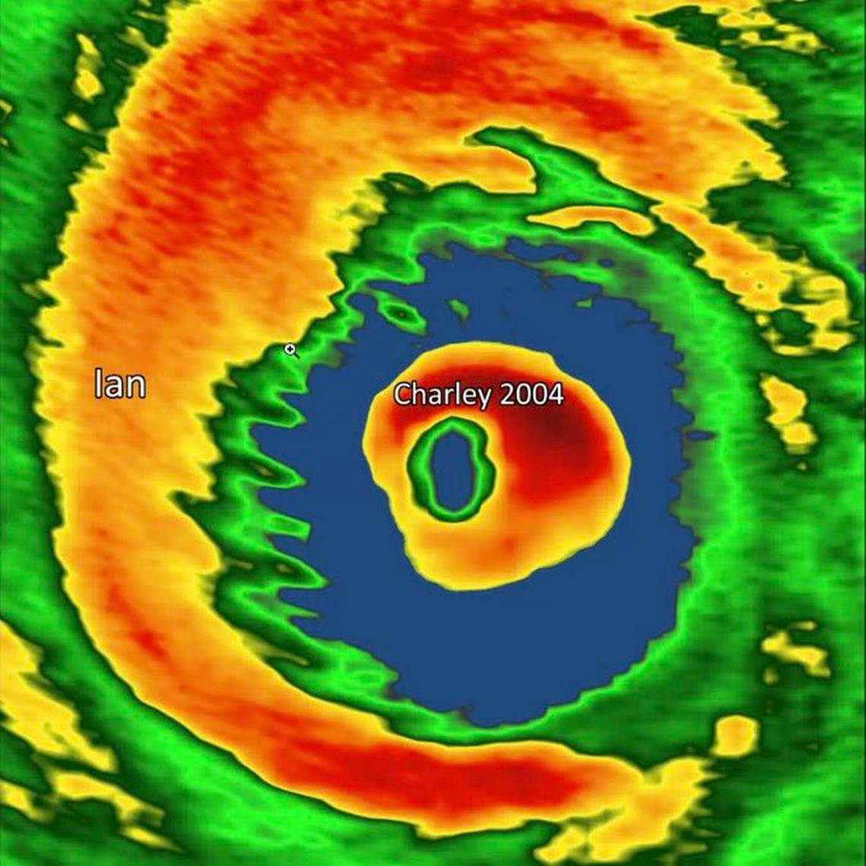
WHY IS THIS IMPORTANT?

Slide 3
Methane 68x more potent as a Greenhouse gas than CO2 in the first 20 years

Slide 4
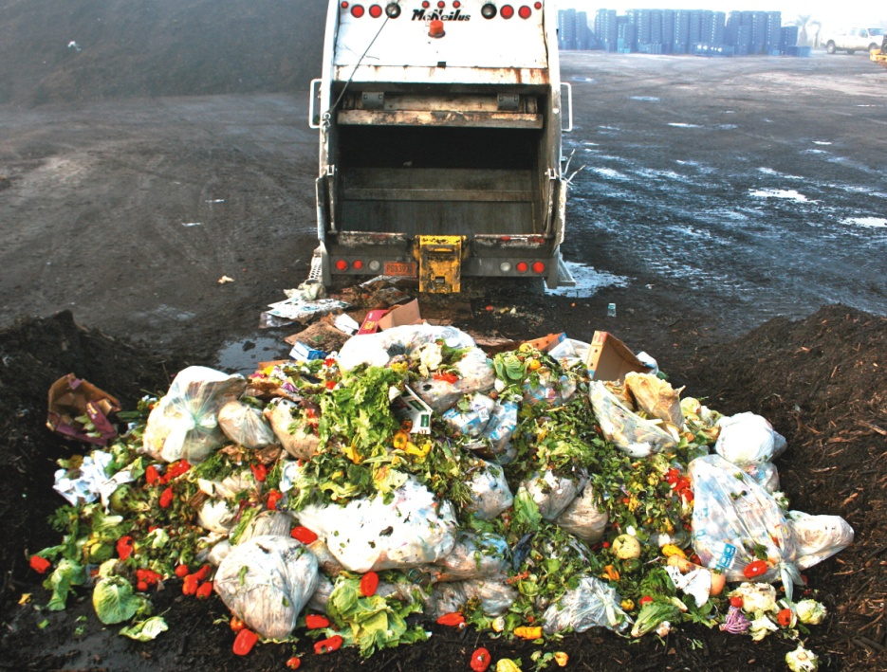
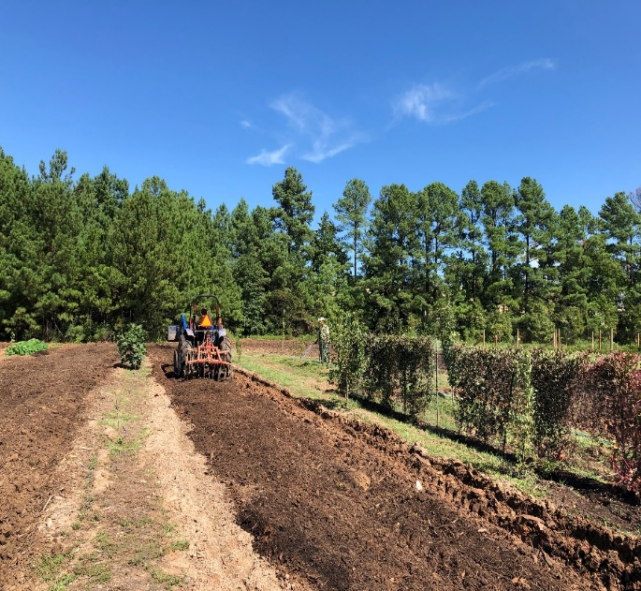
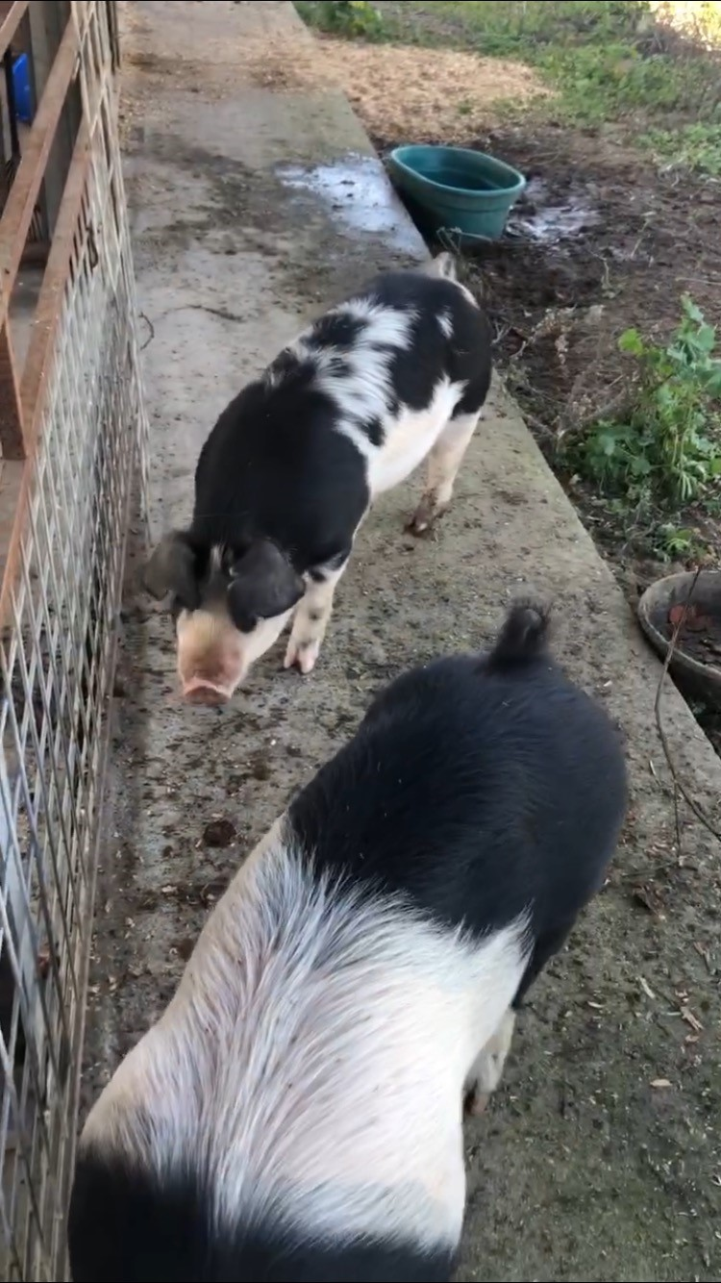
WASTE as a RESOURCE
What we do has profound compounding effects on our environment.

Slide 12
Two School-based Approaches to Cut the Waste & Save the Environment: Cafeteria Share Tables and School Food Forests

Slide 13
Share Tables: Three Take-Aways
Youth learn the value of food. Food is not trash.
One action empowers youth to reduce greenhouse gases & increases access to food, improving student performance, behavior and health.
Saves money and resources

Slide 14
Why food forests matter?
Viriditas
connection between the human spirit and the growth force of the earth
Increases access to fresh, healthy food
Incorporates garden harvested crops into the cafeteria
Creates an outdoor learning lab
Reduces urban heat island effect
Promotes life skill of growing food
Notes:
Improves eating patterns while improving students' academic achievement (science of farming and nutrition) – want to go to the food forest to snack, sense of pride in schools, Miami reported 67% higher science scores & 42% increase in healthy eating habits
Promotes life skill of growing food – boy started growing some of the same food items at home.
Cultivates an attitude of care and creativity
SEL component –boosts mood, self –esteem and confidence. Studies demonstrated shared tasks help group bonding, people connect more easily when they are in nature
Sequesters CO2 - you may have heard of the urban heat island effect – cities hotter because concrete - Helps to alleviate the effects of urban heat islands through establishing ecosystem - BCPS Largest land owner Broward potential

Slide 15
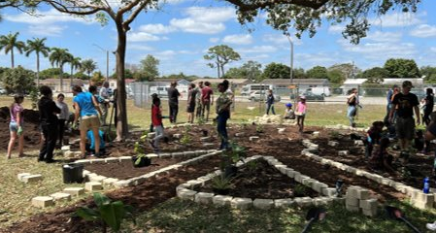
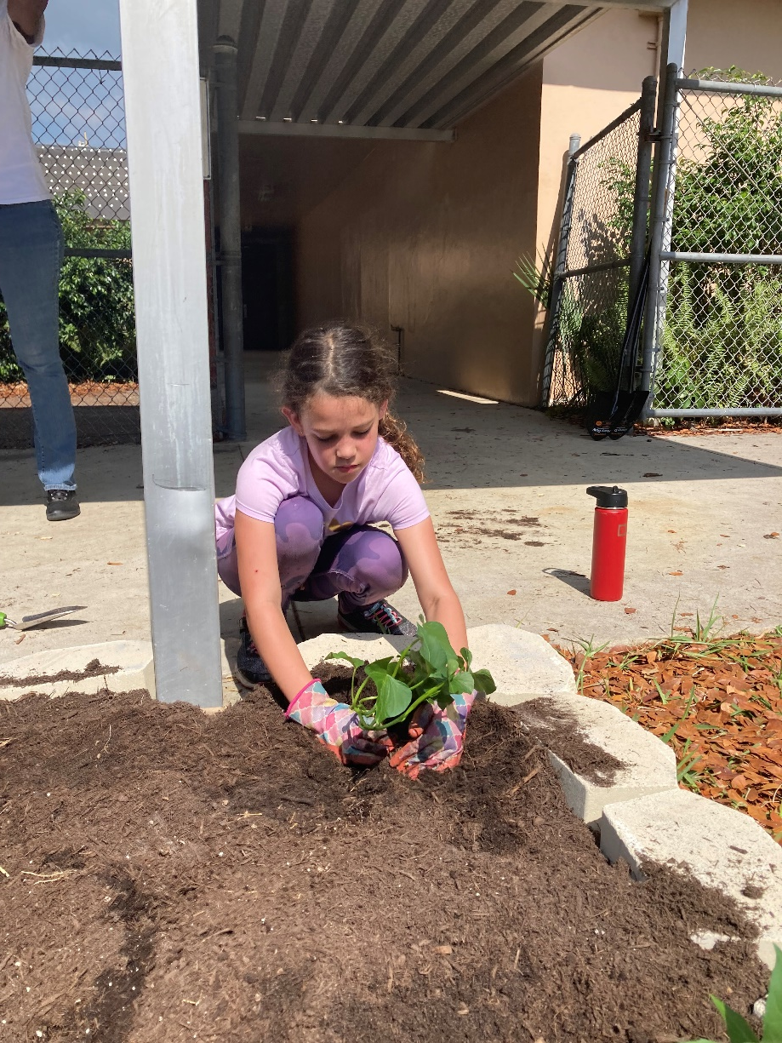
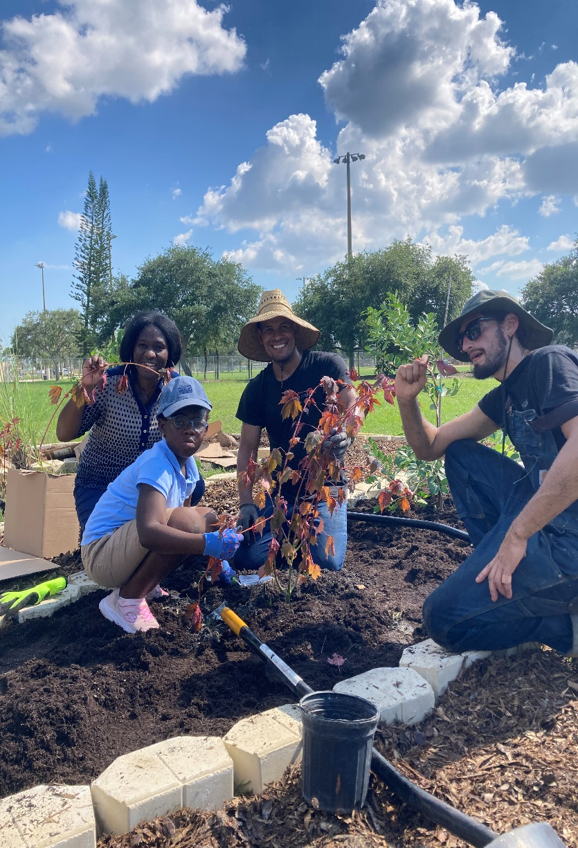
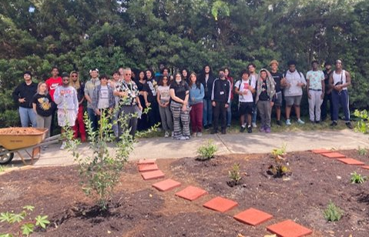
2022 Broward County School Installations

Slide 16
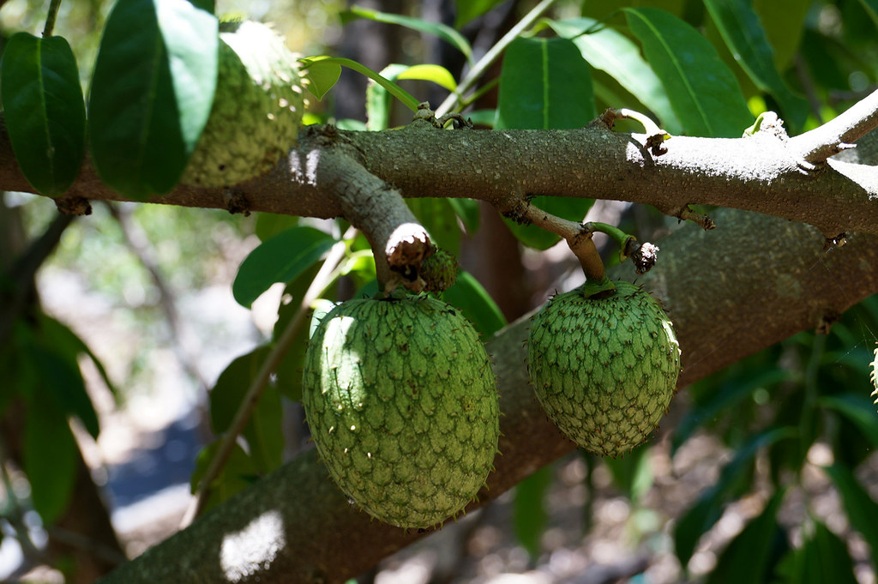
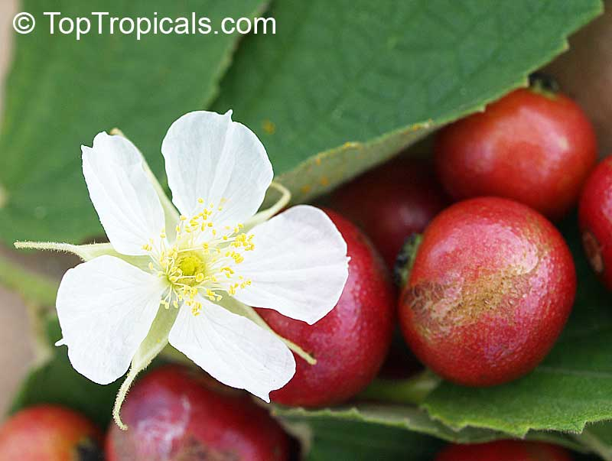
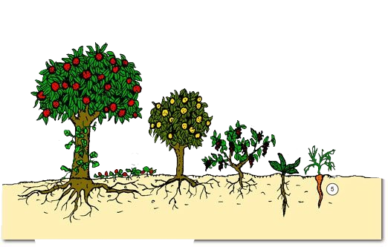
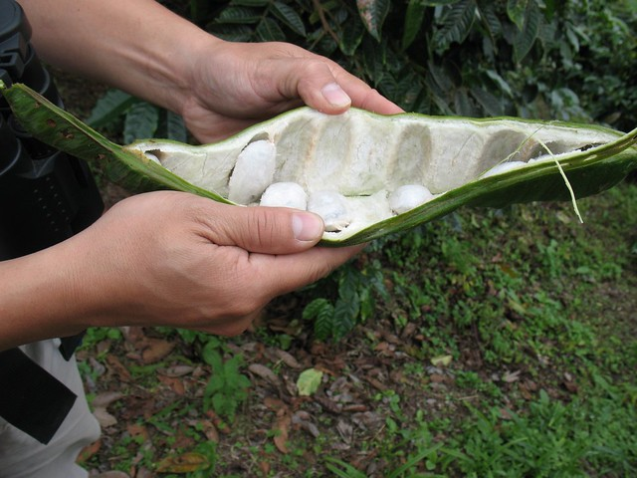
Food Forest Layers
Notes:
This Graphic shows the different layers of the food forest. Emulates what we find in nature. Perennial, edible trees, bushes, herbs, vines and groundcovers. An abundance of tropical, crops that can be found year-round nestled among winding paths. Food forest is a great complement to your school garden because they are sustainable, minimal maintenance and year-round.
Many cities like Atlanta, Portland, NYC have created urban food forests to:
absorbs carbon dioxide and filters the air, enhances biodiversity and yields over a hundred varieties of foods

Slide 17
Resources
Broward County Food & Nutrition Services
Zoe.Crego@browardschools.Com
Means Data Base – Transport Food
Emily@meansdatabase.org
Food Forest
Elaine.fiore@browardschools.com

